Slide 1
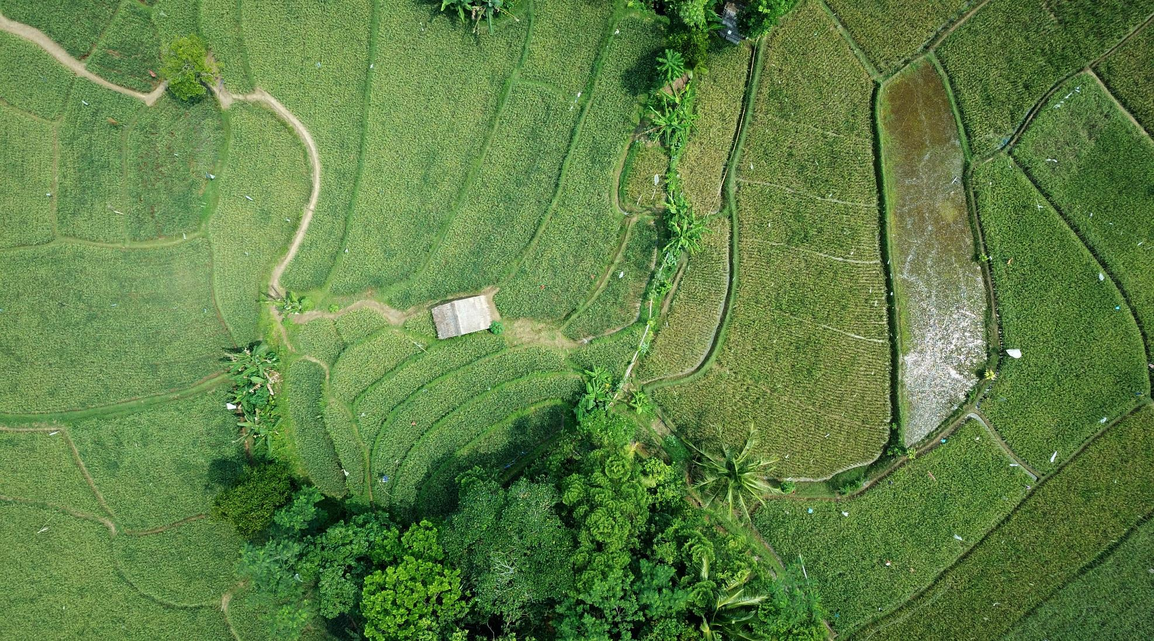
Phytochemistry
Tejas Karandikar

Slide 2
Origin/sources of drugs
Drugs are mainly substances that cause change in an organism’s physiology or psychology when consumed.
In the ancient days, drugs were obtained from natural sources.
For example:-
A) From medicinal plants e.g. the natural extracts from plants
B) From animals
C) From minerals
D) From water bodies such as seas and oceans such as corals
But more recently drugs are also produced by organic synthesis.

Slide 3
Crude Drugs
The drugs obtained from natural sources mentioned in the previous slide are also known as crude drugs.
These crude drugs are classified into two categories.
They are:-
A) Organized crude drugs
B) Unorganized crude drugs
The active ingredients of these drugs are in the form of by-products of plant metabolism known as primary metabolites and secondary metabolites.
The secondary metabolites in plants are mainly classified into three categories:-
A) Nitrogenous
B) Non-nitrogenous
C) Isoprenoids

Slide 4

Isoprenoids
Also known as terpenes or terpenoids, these are the largest and the most diverse groups of secondary metabolites, with nearly 15000 structures known.
These are generally lipophilic polymers based on the simple 5 carbon alkene, 2-methyl- 1,3-butadiene also known as isoprene.
These are synthesized by either the mevalonic acid pathway or the MEP pathway.
Terpenes can be classified into several classes based on the number of carbon atoms.
The large chemical diversity in terpenes comes from the number of units in the chain and the various ways in which they are assembled.
Formation of cyclic structures, addition of oxygen-containing functional groups and conjugation with sugars or other molecules add to their complexity.
The name terpenoid comes from the fact that these compounds were isolated from turpentine, which is an essential oil derived from pine and other coniferous trees.

Slide 5
The terpene family includes hormones like gibberellins and abscisic acid; the carotenoid pigments like carotenes and xanthophylls; sterols like ergosterol, sitosterol, etc. and sterol derivatives like glycosides; latex and many of the essential oils.
Although chlorophyll and cytokinins are not terpenes, they do contain terpenoid side chains.
The sterols, plant hormones gibberellin and abscisic acid and carotenoid and chlorophyll pigments are considered as primary metabolites as they play significant roles in plant growth and development.
Most of them however are secondary metabolites, many of whom appear to act as toxins or feeding deterrents.

Slide 6
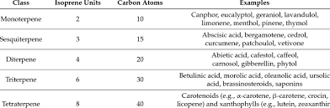
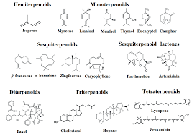
Classes of Terpenoids
25-C terpenoids consist of 5 isoprene units and are known as sesterpenes.
Found in lichens, fungi, insects, sponges, etc.
Examples include Scalarane and Cybastacines

Slide 7
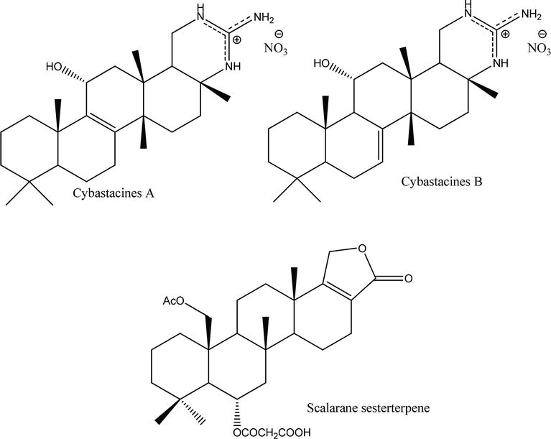
Sesterpenes (general formula C₂₅H₄₀)

Slide 8
Meroterpenes
Apart from these categories/classes of terpenes that we have seen, there is another category of secondary metabolites that have a partial terpenoid skeleton.
Such secondary metabolites are known as meroterpenes.
They are partially derived from the mevalonic acid pathway and found in animals, plants, bacteria and fungi.
Examples of meroterpenes include: -
A) Amestolkolide B (found in a mangrove fungus, Talaromyces amestolkiae YX1)
B) 6-hydroxy-3-methyl-8-phenylethylbenzo[b]oxepin-5-one (found in liverwort Radula sumatrana)
C) Spiroapplanatumines G (found in Ganoderma applanatum, another fungus)

Slide 9
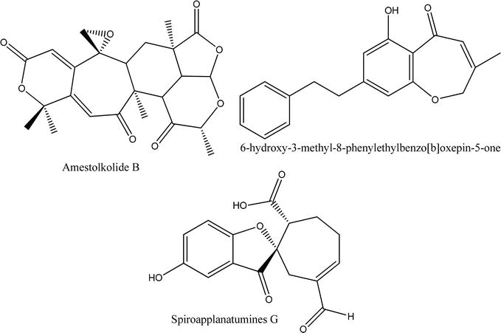
Meroterpenes

Slide 10
Biosynthesis of Terpenes
As seen earlier, the biosynthesis of terpenes occurs in two ways:-
A) Mevalonic acid Pathway
B) MEP Pathway
The Mevalonic acid pathway, also known as the isoprenoid pathway or HMG-CoA reductase pathway is an important metabolic pathway found in eukaryotes, archaea and bacteria.
This pathway produces two 5 carbon building blocks known as isopentenyl pyrophosphate (IPP) and dimethylallyl pyrophosphate (DMAPP) that are used to make isoprenoids.
The pathway starts with acetyl CoA and ends with the synthesis of IPP and DMAPP.
Statins, a class of cholesterol lowering drugs inhibit the above mentioned HMG-CoA and thus stop the synthesis of cholesterol.
The pathway is divided into two sections:-
A) Upper mevalonate pathway
B) Lower mevalonate pathway

Slide 11
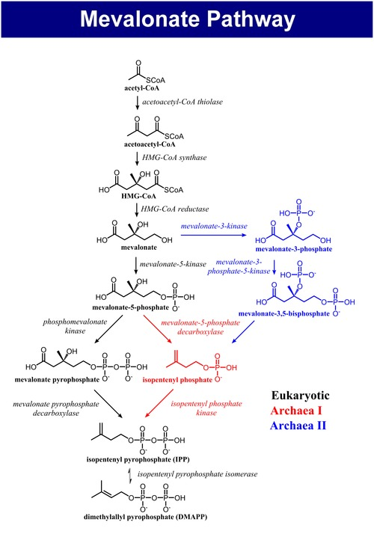
Upper mevalonate pathway
Step 1:- Condensation of Acetyl CoA
In this step, 2 acetyl CoA molecules are condensed to form acetoacetyl CoA.
Step 2:- Condensation of acetoacetyl CoA
In this step, the acetoacetyl CoA formed in step 1 is further condensed to form HMG-CoA (3-hydroxy-3-methyl-glutaryl CoA).

Slide 12
Step 3:- Reduction of HMG-CoA
The reduction of HMG-CoA yields (R)-mevalonate.
These 3 steps are known as the upper mevalonate pathway.

Slide 13
Lower mevalonate pathway
Step 1:- Phosphorylation of mevalonate:-
In this step, mevalonate is phosphorylated at the 5-OH position to form mevalonate-5-phosphate.

Slide 14
Step 2:- Phosphorylation of mevalonate-5-phosphate:-
Here, the mevalonate-5-phosphate obtained in step 1 is further phosphorylated to mevalonate pyrophosphate.
Step 3:- Decarboxylation of mevalonate pyrophosphate:-
In this step, mevalonate pyrophosphate is decarboxylated to form isopentenyl pyrophosphate (IPP) that alternates with its isomeric form, dimethylallyl pyrophosphate (DMAPP).
These two compounds are the building blocks of all terpenoids.

Slide 16
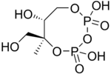
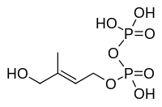


MEP/DOXP Pathway
The 2nd metabolic pathway by which the biosynthesis of isoprenoid precursors IPP and DMAPP occurs is the MEP/DOXP pathway.
It is also known as mevalonate independent pathway or 2-C-Methyl-D-Erythritol 4-Phosphate/1-Deoxy-D-Xylulose 5-Phosphate pathway.
The preferred name for this pathway however is the MEP pathway, since MEP is the first committed metabolite en route IPP.
It occurs in 7 reactions/steps that are as follows:-

Slide 17
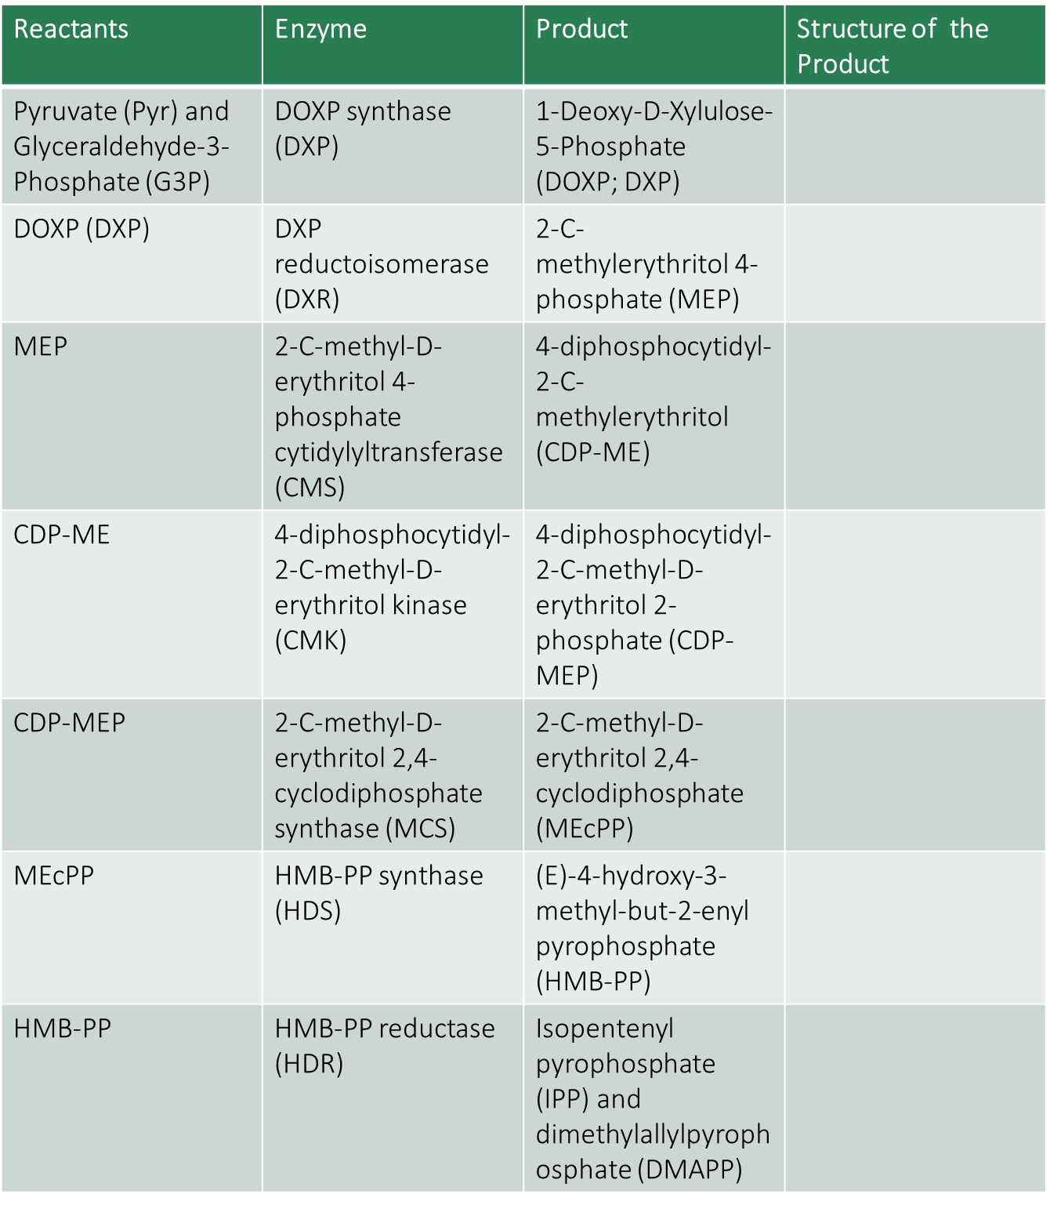

Slide 18
Biosynthesis of terpenes from IPP and DMAPP via Mevalonate Pathway
After the synthesis of IPP and DMAPP by the mevalonate pathway, it gets converted to geranyl pyrophosphate (C₁₀ monoterpene) which on addition of another IPP molecule gets converted to farnesyl pyrophosphate (C₁₅ sesquiterpene)
This farnesyl pyrophosphate gets converted to either geranyl geranyl pyrophosphate (C₂₀ diterpene) by addition of IPP or squalene (C₃₀ triterpene) by addition of farnesyl pyrophosphate.
The subsequent cyclization of squalene leads to the formation of a cyclopentanoperhydrophenanthrene skeleton containing steroidal compounds like cholesterol and triterpenoids.
As seen above, the mevalonate pathway also produces a wide variety of monoterpenoids, sesquiterpenoids, diterpenoids, carotenoids, etc.

Slide 19
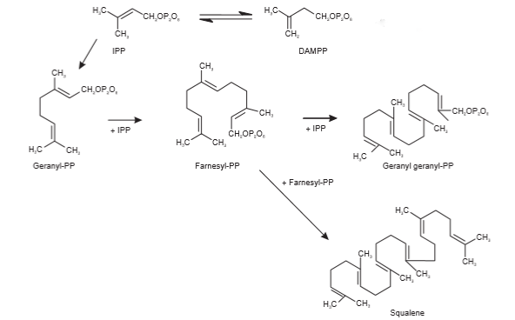

Slide 20
Functions/Applications of Terpenes
A) Terpenes are the constituents of essential oils:-
Many of the plants such as citrus, mint, eucalyptus, lemongrass, etc. synthesise a complex mixture of alcohols, ketones, aldehydes and terpenoids which are known as essential oils.
These essential oils are not only responsible for the characteristic odour and flavour of these plants but are also known to have insect repellent properties.
B) Terpenes have insecticidal properties:-
One of the well known natural insect toxins is pyrethrin, a monoterpene ester which is produced in the ovaries of flowers of Chrysanthemum (Pyrethrum) cineraiifolium.
It is a neurotoxin that interferes with the sodium channels in the insect nerve membrane.
Pyrethrins are popular because they have a comparatively low mammalian toxicity.
They are also inactivated by oxidation and hence don’t persist in the environment.
Many other terpenes, although not insecticidal per se, help in repelling insect invasion of plants.

Slide 21
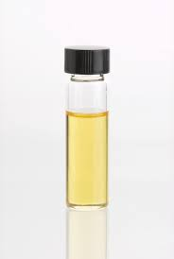
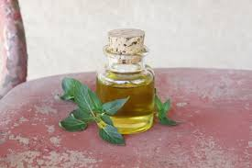
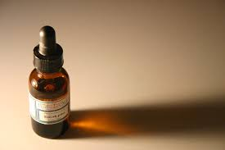
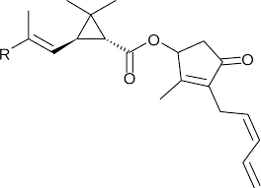
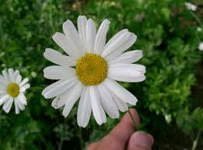
Essential Oils
Pyrethrin
A chrysanthemum flower (Pyrethrum cineraiifolium)

Slide 22
Sterols like stigmasterol, sitosterol, etc. are constituents of plant membranes which is perhaps the most important known function in plants.
Some sterols like phytoecdysones have a protective function.
These phytoecdysones mimic the hormone ecdysone (that helps in molting) produced by insects like caterpillars, thus the insects can’t distinguish them from ecdysone.

Slide 23
So, when the leaves having phytoecdysones are ingested by the insects, these phytoecdysones disrupt the insect’s molting cycle by causing the following to the insects:-
A) Premature molting
or
B) Losing weight
or
C) Other metabolic damage and subsequently death

Slide 24
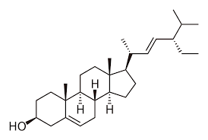
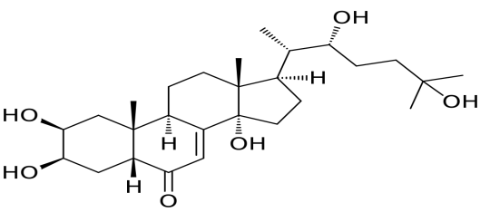
Phytoecdysone
Ecdysone

Slide 25
Non-nitrogenous secondary metabolites of plants
Non-nitrogenous secondary metabolites include a wide range of compounds.
Some of the classes of non-nitrogenous secondary metabolites in plants are:-
A) Glycosides:-
1) Saponins
2) Cardiac Glycosides
B) Phenylpropanoids:-
1) Tannins
2) Lignin
3) Flavonoids and Stilbenes
4) Isoflavones
C) Coumarins and Coumarin derivatives

Slide 26
Glycosides
The term glycoside (Greek:- glykys = sweet) refers to the bond formed when a sugar molecule condenses with another molecule having a hydroxyl group.
Sugars can form glycosidic bonds with other sugars for example when linked together to form polysaccharides or with hydroxyl groups on non-carbohydrate molecules like amino acids or steroids.
Chemically, glycosides are the condensation products of sugar and the acceptor unit known as aglycone.
Three of the most interesting glycosides are the saponins, cardiac glycosides (cardenolides) and the cyanogenic glycosides.

Slide 27
Saponins
Saponins, as the name suggests, are glycosides having detergent properties.
Saponins can occur in the following forms:-
A) Steroid glycosides
B) Steroid-alkaloid glycosides
C) Triterpene glycosides

Slide 28
Like soap (a combination of sodium salt and fatty acid), the combination of hydrophobic triterpene and hydrophilic sugar gives saponins the properties of a surfactant or a detergent.
The name saponin is derived from the plant Saponaria (soapwort) which at one time was used as a soap substitute.
In plants, triterpenoid saponins are synthesised by the isoprenoid pathway by cyclization of 2,3-oxidosqualene to give primary oleanane or dammarane triterpenoid skeletons.
The triterpenoid backbone then undergoes various modifications that are mediated by enzymes.

Slide 29
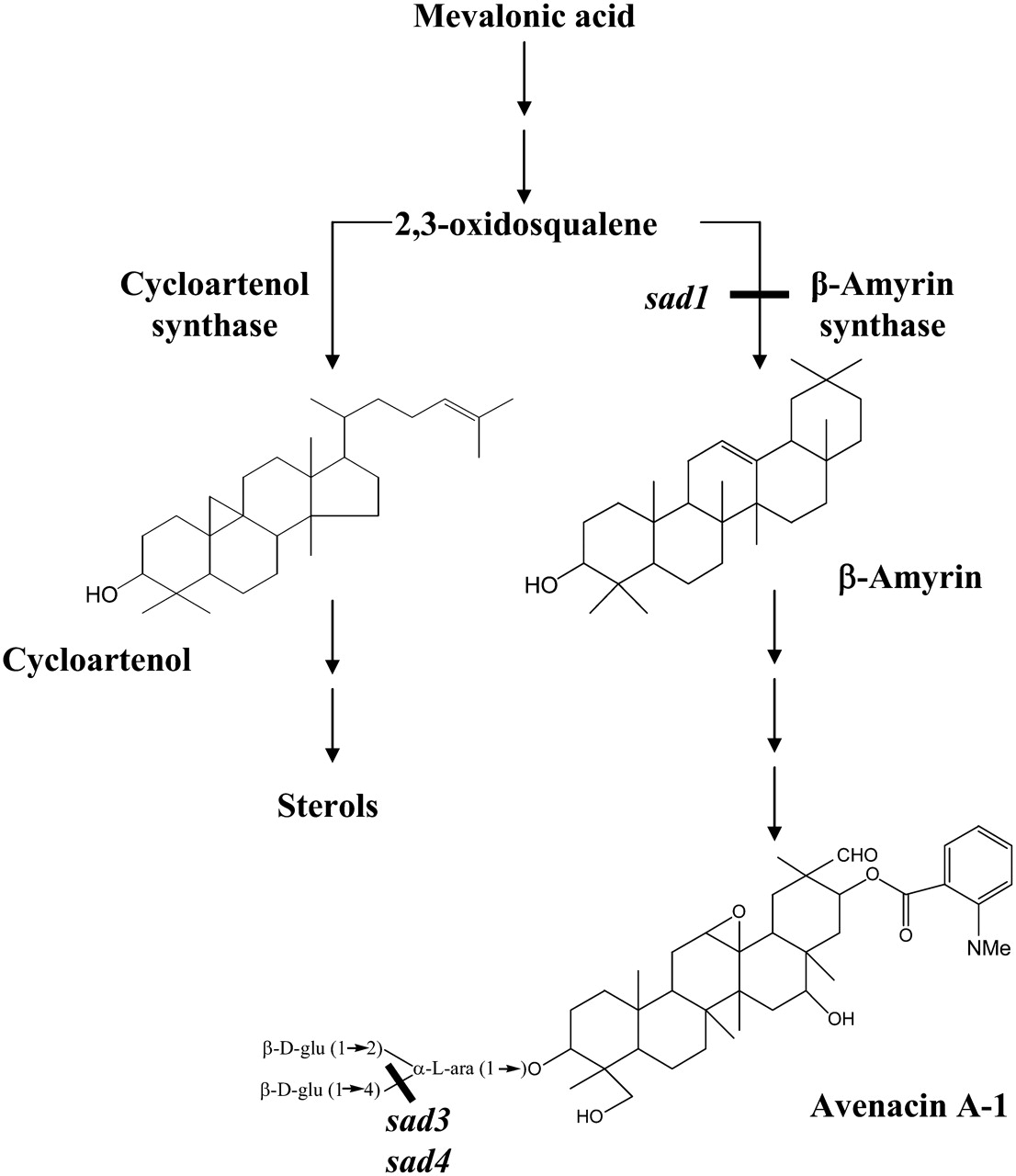
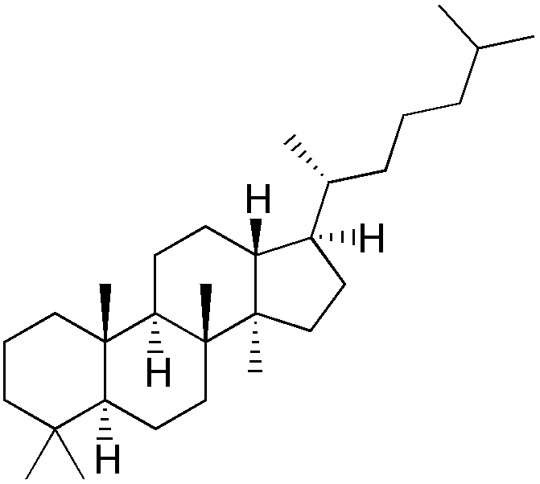
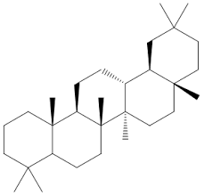
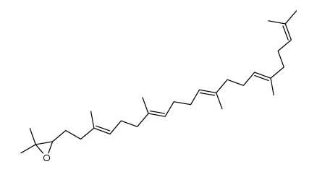
Oleanane
Dammarane
2,3-oxidosqualene

Slide 30
Functions/Applications of Saponins
The main role of saponins appears to be as a preformed defence against attack by fungi.
In the fungal hyphae, when the saponins react with sterols having an unsubstituted 3-β-hydroxyl group, it results in a loss of membrane integrity of the fungal hyphae.
Oat (Avena) produces a triterpenoid saponin known as avenacin A-1 that is localized in the root epidermal cells and effectively protects against a fungal pathogen Gaeumannomyces graminis var. tritici .
Saponins are highly toxic to fish and have been thus used as fish poisons.
Saponins in alfalfa sprouts lower cholesterol levels.
Commercially, saponins from the bark of Quillaja saponaria have been used as surfactants in photographic film, in shampoos, liquid detergents, toothpastes and beverages.
The saponin glyscyrrhizin from licorice (Glyscyrrhiza glabra) has been used in medicines and as a flavour enhancer and sweetener in foods and cigarettes.

Slide 31
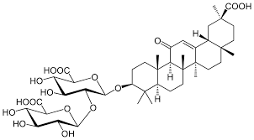
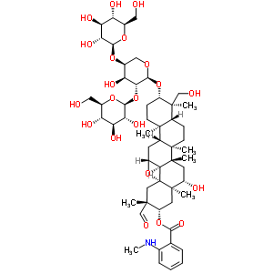
Glycyrrhizin
Avenacin A-1

Slide 32
Cardiac Glycosides/Cardenolides
These are highly toxic steroid glycosides and have similar detergent properties as that of saponins.
They are different from steroid glycosides in that they have a lactone ring attached at C₁₇ and the rare sugars that form the glycoside.
Like the saponins, this class of glycosides occur as the glycoside or aglycone.
They have been recorded in more than 200 species representing 55 genera and 12 families and mainly cause accidental poisoning in humans.
One of the best known example of cardenolides is digitalis, a mixture of cardenolides extracted from the seeds, leaves and roots of the purple foxglove, Digitalis purpurea or Grecian foxglove Digitalis lanata.
The two main cardenolides in digitalis are digitoxin and digoxin.
Other common sources of cardenolides are the milkweeds Asclepias and Calotropis.
Cardiac glycosides are synthesised from Cyclartenol which is obtained from squalene by the mevalonate pathway.

Slide 33
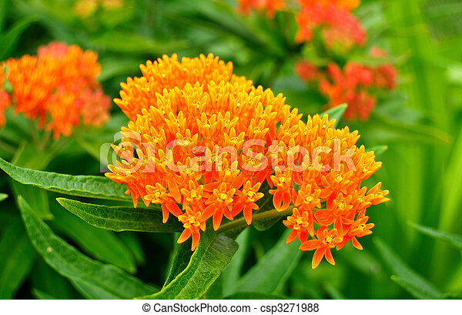
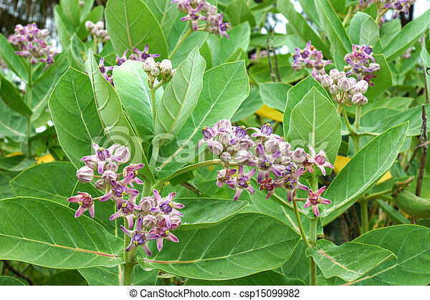
Butterfly weed/ Asclepias
Calotropis gigantea

Slide 34
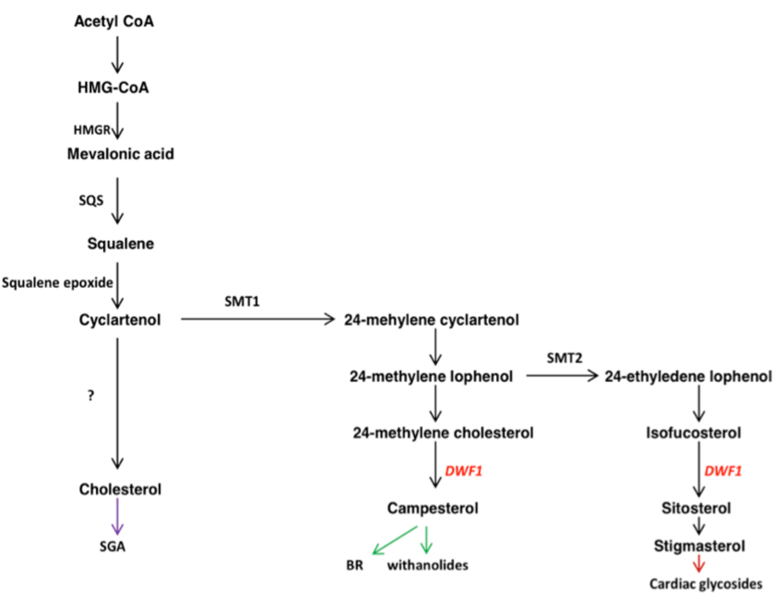
Biosynthesis of Cardiac Glycosides

Slide 35
Applications/Functions of Cardiac Glycosides
A) Therapeutic:-
Digitalis has been used to treat heart conditions such as atherosclerosis since the late 18th century.
B) Hunting:-
The knowledge about the extreme toxicity of cardenolides (resulting from the disruption of cardiac muscle Na⁺/K⁺ ATPase pumps) was used by African hunters who coated their spears and arrows with the cardenolide extract from the plants.
However, at therapeutic doses, cardenolides can both increase as well as decrease the heartbeat.
C) Defence:-
The emerging larvae of monarch butterflies feed on milkweed leaves and store separately the cardenolides present in the milkweed leaves without any ill effect.
When birds like blue jays attempt to feed on the monarch butterflies, the accumulated cardenolides trigger an emetic response which forces the birds to vomit and hence the bird sensibly avoids attempting to feed on monarch larvae.

Slide 36
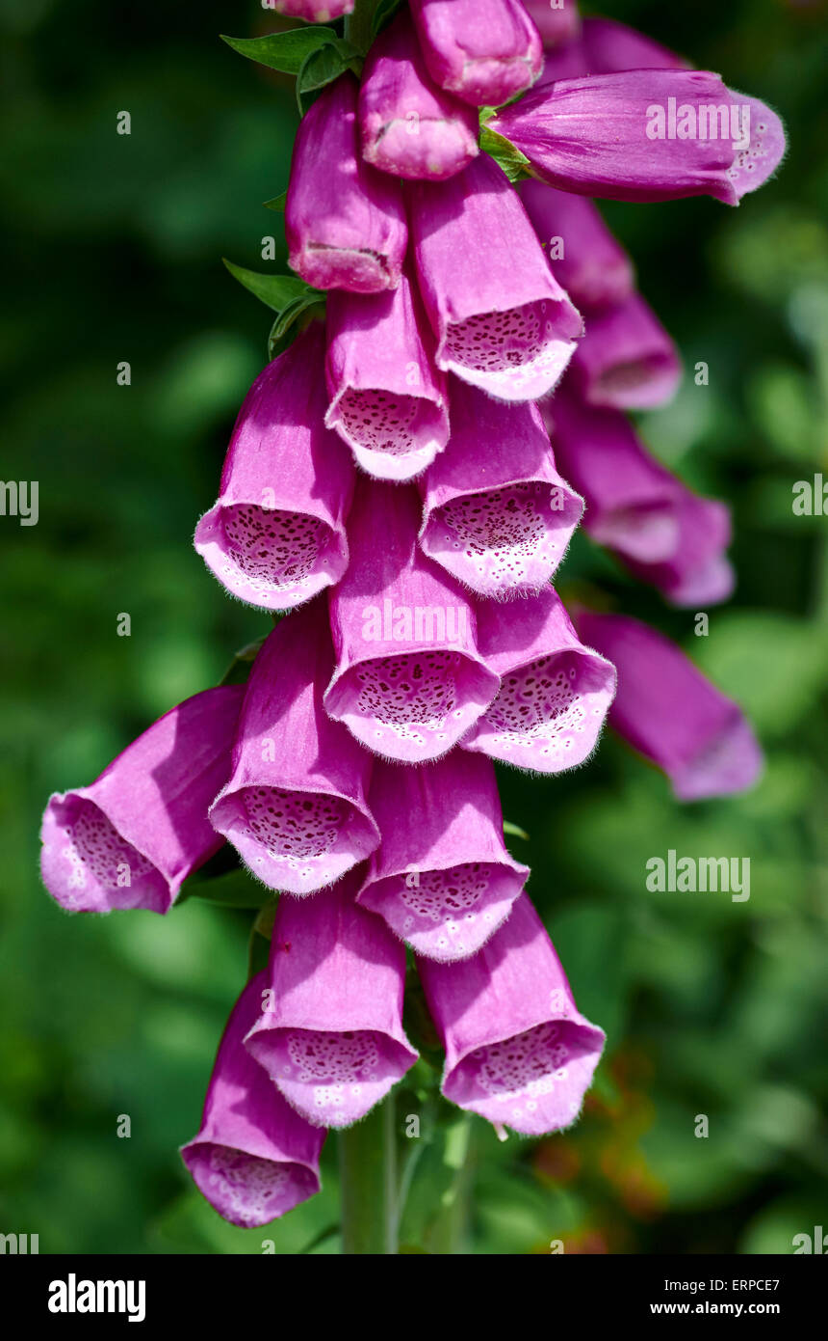
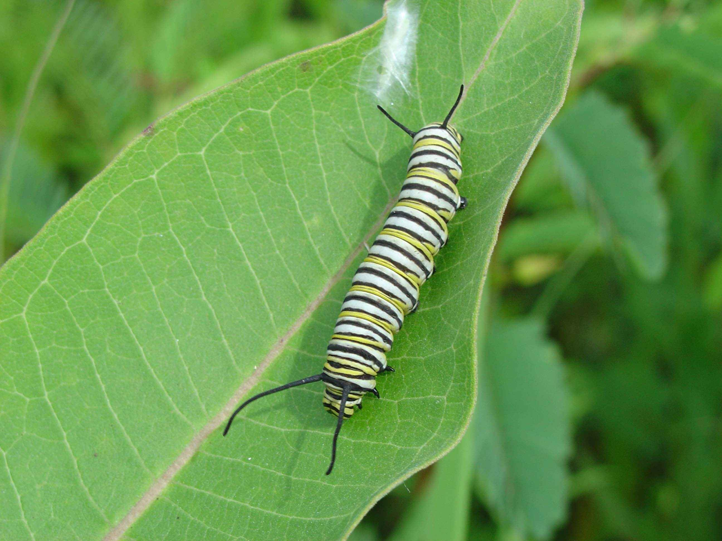
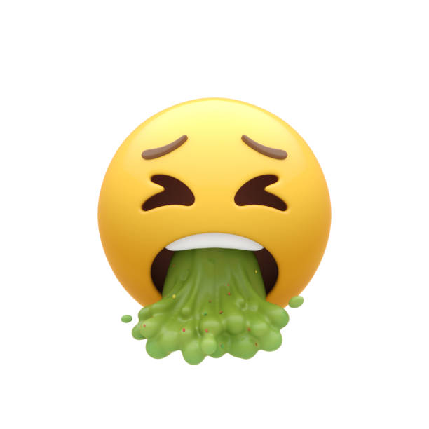
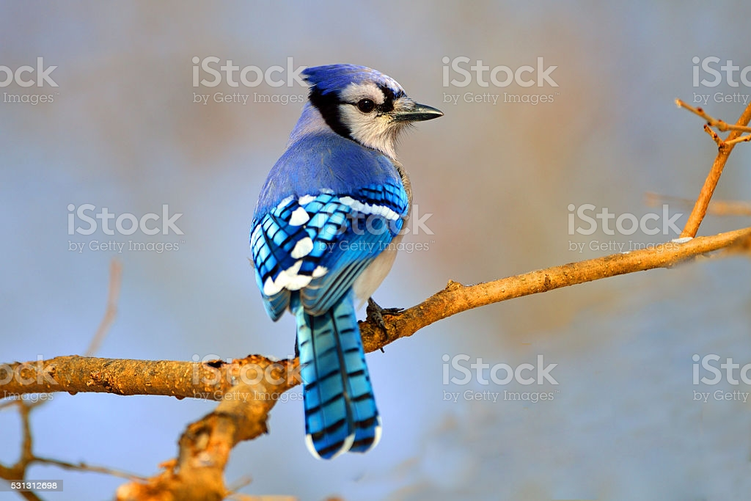
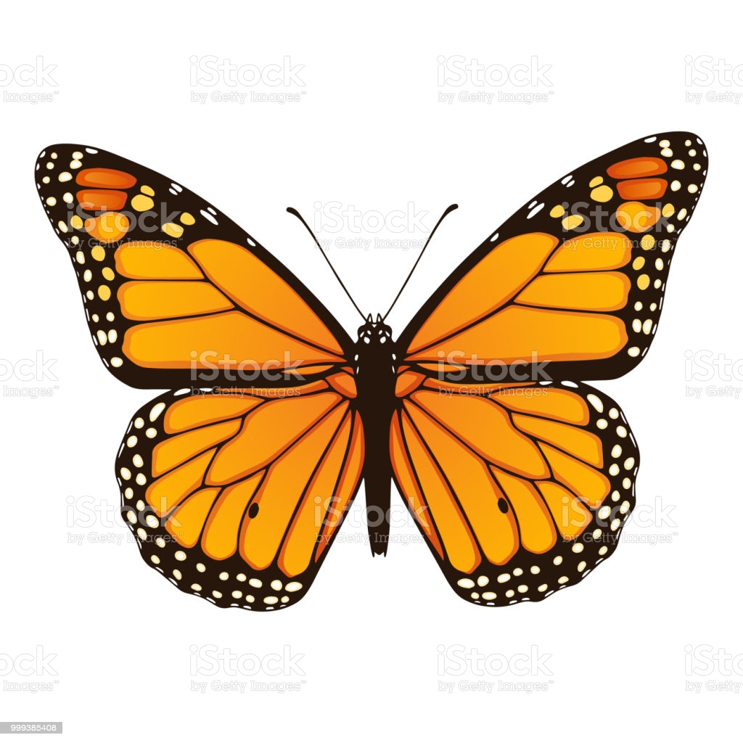

Slide 37
Phenylpropanoids
Phenylpropanoids/phenolics/polyphenols are a large family of secondary metabolites derived from aromatic amino acids.
Phenylpropanoids are a chemically diverse family of compounds ranging from simple phenolic acids to very large and complex polymers such as tannins and lignin.
Flavonoids are also an example of a phenylpropanoid.
The basic structure is phenol, a hydroxylated aromatic ring.
Many phenolics are involved in plant/herbivore interactions like other secondary metabolites.
Some are important structural components while others are simply metabolic end products with no function.

Slide 38
Tannins
Historically, plant extracts were used to “tan”/treat skins and hides of animals to produce leather.
The word “tannin” was derived from this historic practice.
Such extracts contain a mixture of chemically complex phenol derivatives which attach to and therefore denature proteins.
In fact, the most common test for tannins was their capacity to precipitate gelatin.
There are two categories of tannins that are now recognised:-
A) Hydrolysable tannins
B) Condensed tannins
Hydrolysable tannins as the name suggests are those type of tannins that on heating with HCl or H₂SO₄ give the base compounds of tannins i.e. gallic or ellagic acids.
They are also hydrolysed by weak acids or weak bases to give carbohydrates and phenolic acids.
For example:- Gallic esters of glucose in tannic acid (C₇₆H₅₂O₄₆) found in the leaves and barks of many plants like Caesalpinia spinosa/ Tara pods, oak bark and leaves, etc.

Slide 39
Condensed tannins are polymers of flavonoid units that are linked by strong carbon-carbon bonds.
These bonds don’t get hydrolysed but they can be oxidised by strong acid to release anthocyanidins.
For example:- Procyanidins are a type of condensed tannins that are found in grape (Vitis vinifera) seeds.
Condensed tannins are also found in bark of trees like pine, mimosa, spruce, etc.

Slide 40
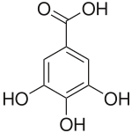
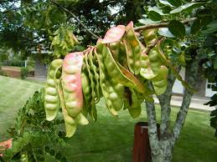
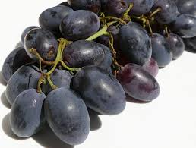
Gallic acid
Black grapes/ Vitis vinifera
Caesalpinia spinosa/ Tara pods

Slide 41
Role of Tannins
Similar to other phenolics, the biological role of tannins is still unclear.
Tannins do appear to deter feeding by many animals.
This effect is related to their astringency- a sharp, somewhat unpleasant sensation in the mouth.
This astringent property of tannins is what gives coffee, tea and wine their characteristic flavour.
Industrial Applications:-
A) As we have seen earlier, tannins are used in tanning leather, although inorganic tanning agents are also in use today.
B) Tannins are also used as wood adhesives and it has become the second most important industrial application after tanning of leather.

Slide 42
Pharmaceutical and Medical Applications:-
Tannins have a bactericidal activity because they react with the bacterial proteins irreversibly, thus complexing within the bacterial membranes and neutralizing the activity.
Hence, tannin-based pharmaceuticals have been marketed for a long time to cure intestinal infections.
They also have anti-caries properties.
Many experimental studies on the pharmaceutical use of tannins have been published with their anti-oncogenic activities well documented.
The anti-viral effectiveness of tannins has also been well documented by in vitro screening for a variety of 12 different hydrolysable and condensed tannins like chestnut tannin extract, pine bark tannin extract, etc.
The extract of Stryphnodendron rotundifolium and also of other tannins has proven their effectiveness against ulcers.
The anti-oxidant property of the polyphenolic groups of tannins give them a powerful anti-cardiovascular effect.

Slide 43
Production of Fireproof and Insulating foams:-
Tannins are used for the production of self expanding rigid foams.
These foams are used for very good acoustic insulation.
They are also used for bone repair by osteogenesis with stem cells.
1) PTSDP (Porous tannin spray dried powder), the powder derived by grinding tannin-furanic foams has been approved for human use.
2) Hence, the above powder has been used as a low cost reconstruction material because of its biocompatibility and its potential ability to be replaced by bone in vivo.

Slide 44
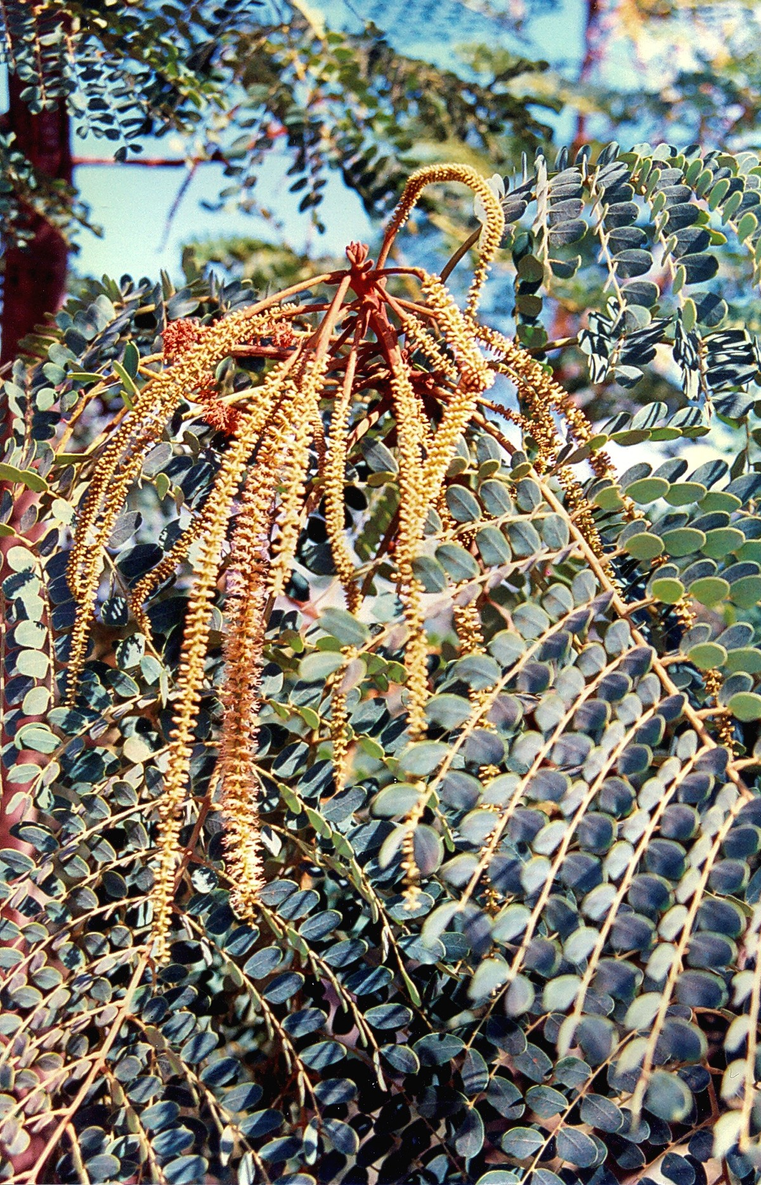
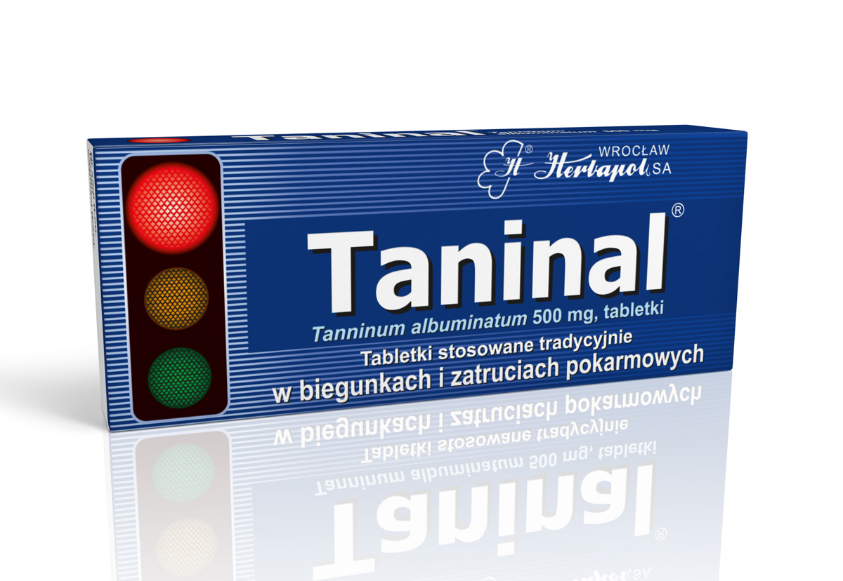
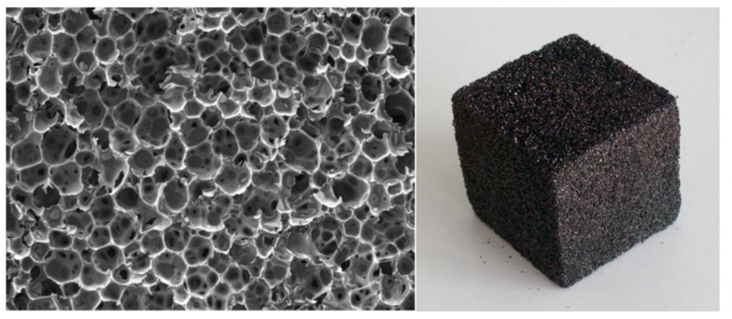
Translation of the words written on the box:-
Traditional tablets used in diarrhoea and food poisoning

Slide 45
Lignin
It is a highly branched polymer of three simple phenolic alcohols known as monolignols (coniferyl alcohol, sinapyl alcohol and coumaryl alcohol).
Lignin in gymnosperms is made up of mainly coniferyl alcohol subunits while in angiosperms it is made up of a mixture of coniferyl and sinapyl alcohol subunits.
Lignin is found in cell walls, especially in the secondary walls of tracheary elements in the xylem.
Despite its abundance, its structure is not yet well understood.
It is a very large polymer, insoluble in water and most organic solvents and impossible to extract without considerable degradation.
Also, the three basic monomers can link to each other in a number of ways to form a multi-branched 3D structure.
The complexity is so great that like snowflakes, each lignin molecule may be unique.
In lignified woody stems, there is a high degree of mechanical rigidity and strength because of the ability of lignin to form several cross-links with other cell wall polymers.

Slide 46
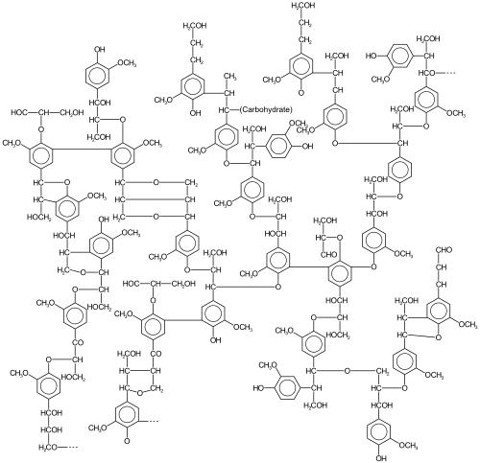

Slide 47
Biosynthesis of Lignin
Lignin is synthesised in the cytosol starting with the synthesis of glycosylated monolignols from phenylalanine.
These initial reactions are shared with the phenylpropanoid pathway.
The attached glucose makes it water soluble and less toxic.
Once it is transported through the cell membrane to the apoplast, the glucose is removed and the polymerization begins.
The anabolism of lignin is not yet well understood even after more than a century of its study.
It is believed that the alcohols are oxidized to free radicals by oxidative enzymes and then these free radicals spontaneously react and form polymeric lignin.
The enzymes involved may be peroxidase or oxidase or maybe both.

Slide 48
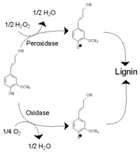

Slide 49
Role of Lignin
Lignin is a major structural component of cell walls and it is what makes wood, wood.
Besides it playing a structural role, lignin has also been thought of as a defensive chemical.
Lignin is not easily digestible by herbivores and because it is covalently bonded to cellulose and cell wall xyloglucans, its presence lowers the digestibility of these polymers as well.
In case of a fungal invasion, lignin and other phenolic derivatives accumulate at the site of fungal penetration, presumably slowing the amount of time it takes to degrade the cell wall.
In sulphite pulping (extraction of lignin by using various salts of sulphurous acid), lignin is removed in the form of lignosulphonates for which many applications have been proposed.
For example:- Lignosulphonates are added along with water in concrete so that its water to cement ratio is reduced, thereby increasing its durability.
Lignin extracted by the Kraft process (extraction of lignin with the help of a mixture of water, NaOH and Na₂S) is generally burned for its fuel value which gives the energy to power the paper mill.

Slide 50
Because it is the 2nd most prevalent biopolymer after cellulose, lignin is being investigated as a feedstock for biofuel production and can also be an important plant extract in the creation of a new class of biofuels.
Pyrolysis of lignin during burning of wood or production of charcoal gives a variety of products out of which the most characteristic ones are methoxy-substituted phenols.
Out of the methoxy-substituted phenols, the main ones are guaiacol, syringol and their derivatives.
In cooking, lignin in the form of hardwood is the main source of these 2 compounds which give the characteristic aroma and taste to smoked foods like barbecue.
For example:- The main flavour imparting compounds in smoked ham are guaiacol and its 4-,5-,6- methyl derivatives as well as 2,6-dimethylphenol.

Slide 51
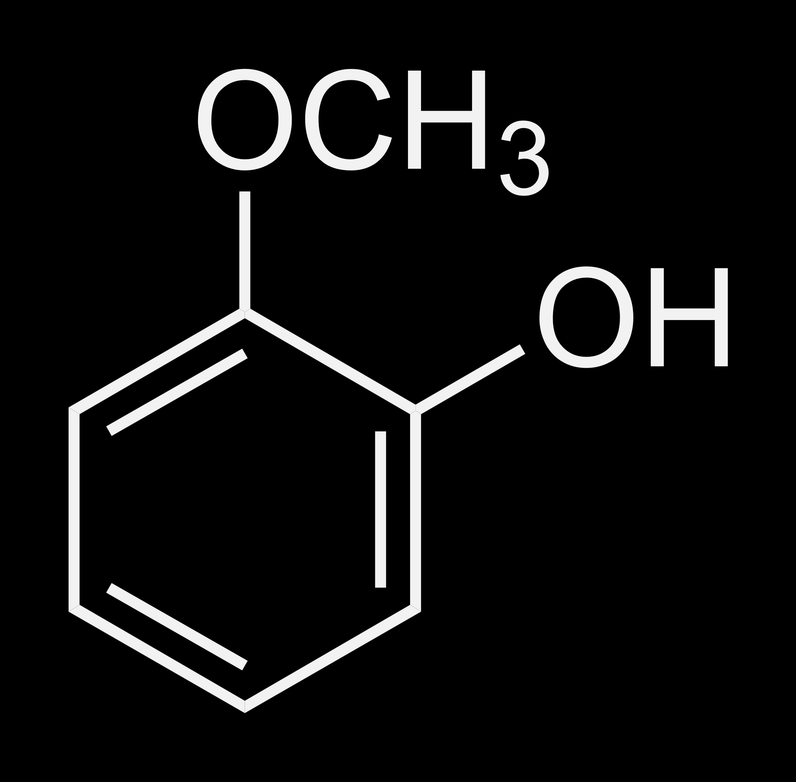
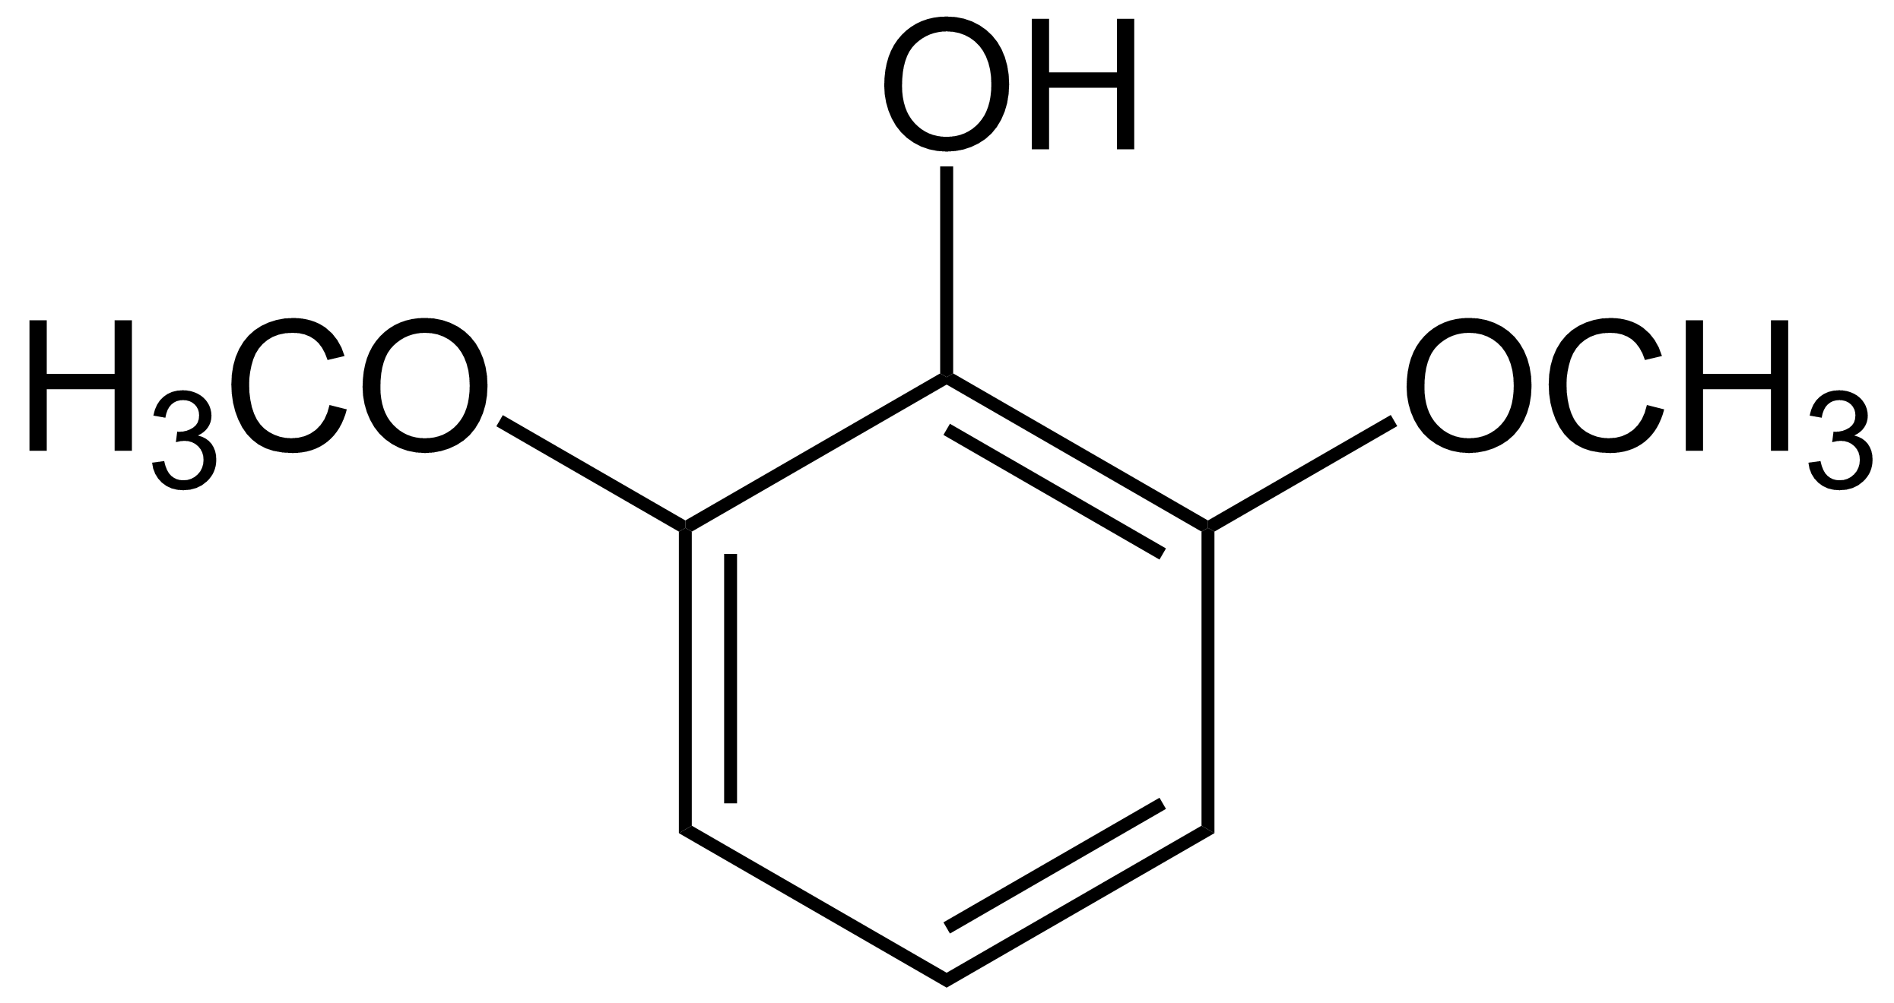
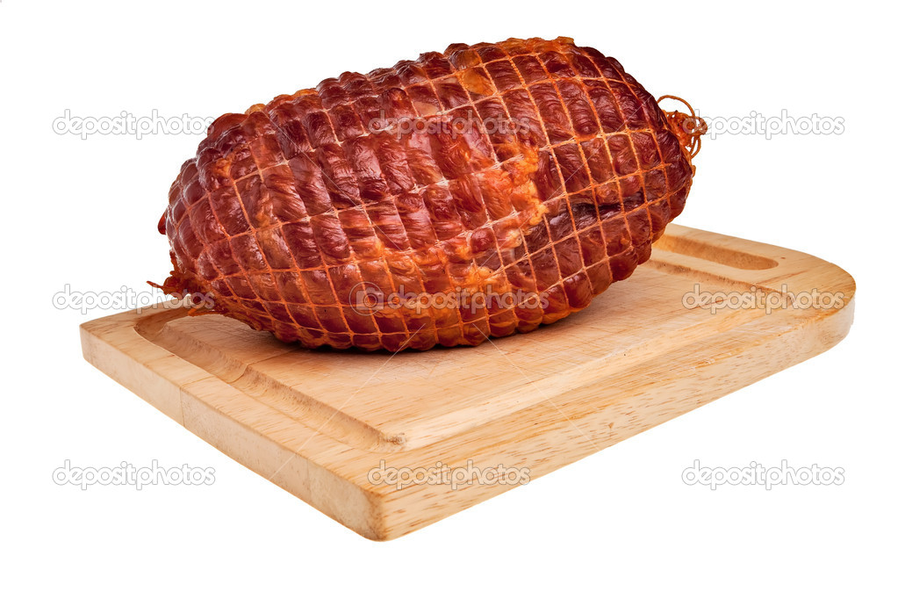
Guaiacol
Syringol
Smoked ham

Slide 52
Coumarins and Coumarin Derivatives
Coumarins are a family of benzopyrones that are widely distributed in nature.
The name coumarin comes from coumarou, the French word for the Tonka bean, seeds of the legume Dipteryx odorata/Coumarouna odorata, one of the sources from which coumarin was first isolated as a natural product in 1820 by A. Vogel of Munich who initially thought it was benzoic acid.
In the same year, Nicholas Jean Baptiste Gaston Guibourt of France independently isolated coumarin and realised that it wasn’t benzoic acid unlike Vogel and named the substance coumarine.
Coumarin has a sweet smell that can be easily recognized as the scent of new mown hay.
Coumarinic compounds/Coumarin derivatives are a class of lactones structurally made up of a benzene ring fused to an α-pyrone ring.
The simplicity and versatility of the coumarin structure make it a great starting point for numerous applications.

Slide 53
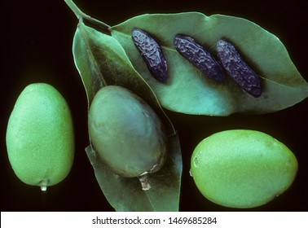
Tonka bean (Dipteryx odorata or Coumarouna odorata)

Slide 54
Biosynthesis of Coumarins
Simple coumarins are derived from shikimic acid via cinnamic acid.
The specificity of the process comes in during the C-2 hydroxylation, which causes a β-oxidation of the side chain and lactonization, producing a simple coumarin known as umbelliferone.
Pyrano and furocoumarins are also produced from shikimic acid.
One of the derivatives of coumarin, dicoumarol, first isolated from decomposed leaves of Melilotus albus, is hypothesised to be produced by the hydroxylation of the 4- position of coumarin, which then captures a molecule of formaldehyde and is condensed with another molecule of 4-hydroxycoumarin and finally enolizes the keto group to form dicoumarol.

Slide 55
Applications of Coumarins
As a family, coumarins act as antimicrobial agents, feeding deterrents and also germination inhibitors.
Coumarin is a constituent of Bergamot oil, an essential oil that is used to flavour pipe tobacco, tea and other products.
The discovery of dicoumarol in the 1940s led to the development of WarfarinTM which is widely used as a rat poison as well as a drug which acts as a blood thinner.
Being sweet in smell, coumarin has been used in perfumes since 1882.
The main source of coumarin in our diet is cinnamon, which is used in various cultures to prepare foods like cakes, desserts, candies, curries, etc. and also as tea.
Dihydrocoumarin is added as a flavouring agent to food and cosmetics.
The coumarin from the plant Hierochloe odorata is used to flavour a special kind of vodka which is produced mostly in Eastern Europe.
Coumarins have anticlotting, hypotensive, antimicrobial, anti-inflammatory and anti-tumour activities.

Slide 56
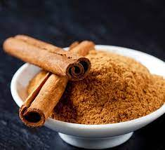
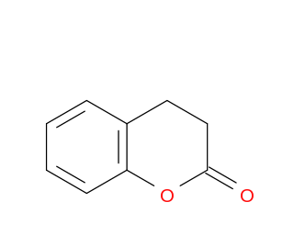
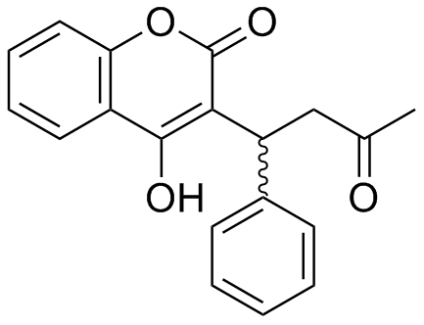
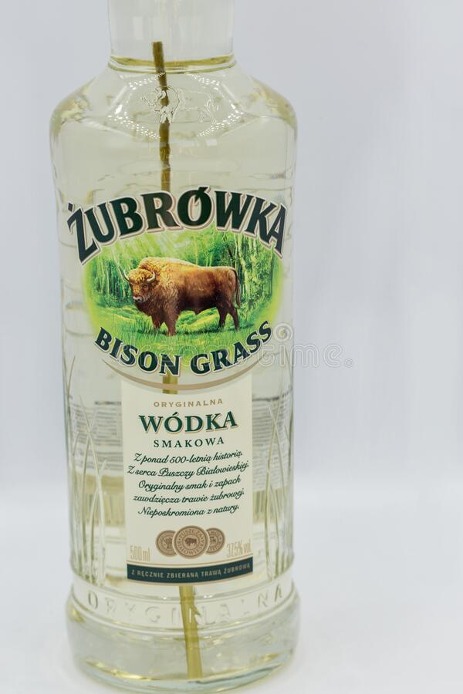
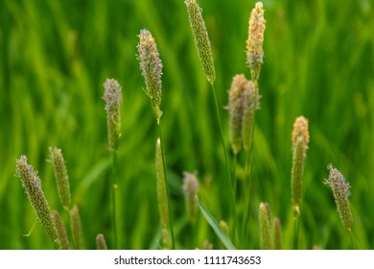
Dihydrocoumarin
Warfarin™
Hierochloe odorata

Slide 57
Nitrogenous Secondary Metabolites
As the name suggests, these are the heterogeneous compounds that contain nitrogen in their structure.
The 4 main groups of nitrogenous secondary metabolites present in plants are:-
A) Cyanogenic Glycosides
B) Glucosinolates
C) Alkaloids
D) Non-protein amino acids

Slide 58
Cyanogenic Glycosides
These are a group of nitrile (-C≡N) containing compounds that produce cyanide after their enzymatic breakdown.
Despite the structural diversity in cyanogenic glycosides, they are essentially made up of 6 amino acids viz. L-valine, L-isoleucine, L- leucine, L-phenylalanine, L-tyrosine and cyclopentenyl glycine.
On their own, cyanogenic glycosides are not toxic. But, when the plants containing such cyanogenic glycosides are chewed by herbivores or when the plants are disintegrated during processes like grinding, hydrolysis occurs leading to the release of cyanide in the form of HCN.
Approximately 25 cyanogenic glycosides are known and they are found in the edible parts of plants like apples, apricots, cherries, etc.
They are also found in almonds, bamboo shoots, chick peas, cashews, etc.

Slide 59
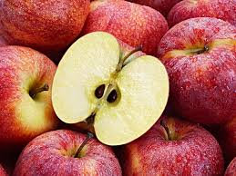
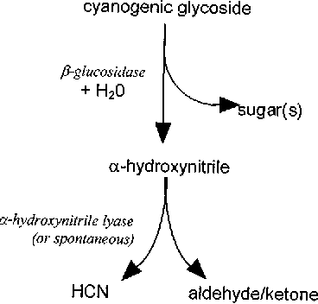


Slide 60

Biosynthesis of Cyanogenic Glycosides
The precursors for the biosynthesis of cyanogenic glycosides are amino acids.
The biosynthesis of cyanogenic glycosides occurs in 5 steps:-
Step 1:- Hydroxylation of amino acid
An amino acid is first hydroxylated to yield N-hydroxylamino acid.
Step 2 :- Conversion of N-hydroxylamino acid
The N-hydroxylamino acid obtained is then converted to an aldoxime.

Slide 61
Step 3:- Dehydration of the aldoxime
The aldoxime is then converted to a nitrile by the removal of water.
Step 4 :- Oxidation of nitrile
The nitrile is then oxidised to form α-hydroxynitrile.

Slide 62
Step 5 :- Glycosylation of α-hydroxynitrile
Finally, the α-hydroxynitrile is glycosylated to form a cyanogenic glycoside.

Slide 63
Glucosinolates
Glucosinolates are a class of natural organic compounds that have sulphur and nitrogen and are derived from glucose and an amino acid.
They are water soluble anions and belong to the class of compounds known as glucoside.
Every glucosinolate has the following atoms:-
1) A central carbon atom attached to the:-
A) Thioglucose group
B) Sulphate group
C) Side group*
2) A sulphur atom that connects the thioglucose group to the central carbon.
3) A nitrogen atom that connects the sulphate group to the central carbon.
* indicates that the side group varies from one glucosinolate to the other.

Slide 64



Slide 65



Sources of Glucosinolates
Glucosinolates are found mostly in the family Brassicaceae (mustard family) and other related families in the order Capparales.
Glucosinolates are found in edible plants like broccoli, cabbage, radishes, cauliflower, etc.
Glucosinolates are also found in the seeds of these plants.
Glucosinolates are the ones which give these plants their characteristic pungent taste as well as the distinct flavour.

Slide 66

Biosynthesis of glucosinolates
The pathway followed by plants for the biosynthesis of glucosinolates is given below:-

Slide 67
Catabolism of Glucosinolates
The catabolism/hydrolysis of glucosinolates is brought about by the enzyme called myrosinase (a thioglucosidase).
The hydrolysis product is extremely unstable and gets immediately converted to either a thiocyanate or an isothiocyanate.
Similar to cyanogenic glycosides, the glucosinolates are separated from the hydrolytic enzymes and only on cell disruption do the enzyme and substrate come together.
The biological activity of glucosinolates depend mainly on their hydrolysis to mustard oils.

Slide 68


Slide 69
Role/Functions of Glucosinolates
The main role of glucosinolates in a plant is to deter herbivores or repel them i.e. glucosinolates like other secondary metabolites have a defensive/protective role in plants.
Glucosinolates also function as attractants for insects in order to stimulate feeding or ovipositing i.e. laying eggs.
In the studies on rats, the vegetables that contain glucosinolates have been shown to inhibit the development of cancer of bladder, breast, colon, liver, lung and stomach.
Hence, they may possibly help to prevent cancer in humans, although the results have been mixed as far as humans are concerned.
Commercially speaking, there has been a significant impact of glucosinolates on the oilseed industry.
Rape seed (Brassica napus) is a good source of vegetable oil, but the high content of glucosinolate and a 22 carbon fatty acid known as erucic acid give the oil an undesirable taste and poor storage properties.
Hence, new strains of rape plants known as canola have been bred that are low in glucosinolates and erucic acid and are therefore an economically important food source.

Slide 70


Slide 71
Alkaloids
Alkaloids are one of the largest group of secondary metabolites that are produced by plants.
More than 10,000 different alkaloids have been found in species from more than 300 plant families.
An alkaloid is a nitrogenous organic molecule that has a pharmacological effect on both humans as well as animals.
They occur in plants as salts of common carboxylic acids like citric, benzoic, maleic, lactic, etc.
They produce an alkaline solution in water because of their amine character and hence the name alkaloids.
Structurally speaking, alkaloids have one or more rings of carbon atoms, typically with a nitrogen atom inside the ring, although there are some alkaloids like mescaline that has the nitrogen atom outside the ring.
The position of this nitrogen atom affects the properties of alkaloids.
They occur in seed bearing plants and are found in their roots, bark, leaves, fruit and berries.
Most of them have a bitter taste.

Slide 72

Biosynthesis of Alkaloids
Amino acids are the basic building blocks of alkaloids.
Different alkaloids have different biosynthetic pathways according to the amino acids that are involved in their formation.
For example:-
A) Ornithine derivatives e.g. nicotine:-
Ornithine is a precursor of the cyclic pyrrolidines which are found in the alkaloids of tobacco (nicotine, nornicotine) and in the solanaceae family.

Slide 73
B) Tryptophan derivatives e.g. Vinca alkaloids:-
Tryptophan and its decarboxylated product tryptamine are the precursors for the biosynthesis of a broad variety of indole alkaloids of which the vinca alkaloids are the examples.

Slide 74

Biosynthesis of vinca alkaloids

Slide 75
Role of alkaloids
Name of the alkaloid | Use
Atropine | Treatment of bradycardia, poisoning by nerve agents
Caffeine | CNS stimulant, improves athletic performance
Cocaine | Nasal surgery, illegal recreational drug
Codeine | Relieves coughing, treatment of diarrhoea
Hyoscyamine | Relief of spasms due to lower abdominal and bladder disorders
Morphine | Treatment of acute and chronic severe pain
Nicotine | Treatment of nicotine dependence, insecticide, cigarettes, e-cigarettes, etc.
Quinine | Alternative anti-malarial, beverages, standard in photochemistry

Slide 76






Atropine
Caffeine
Cocaine
Codeine
Hyoscyamine
Morphine

Slide 77


Gin and Tonic

Slide 78
Integrated pathway for the production of secondary metabolites
We had seen earlier distinct pathways for the production of different classes of secondary metabolites in plants.
But, in actuality, all of these pathways are inter-related to each other.
This is because a single primary metabolite produced by plants is used as a precursor for the production of many secondary metabolites.
The three main pathways that form a part of this “integrated pathway” for the production of secondary metabolites are:-
A) Acetate-Mevalonate Pathway/Mevalonic acid Pathway
B) Acetate-Malonate Pathway/MEP Pathway
C) Shikimic acid pathway

Slide 79

b

Slide 80
Shikimic Acid Pathway
One of the most important pathways for the biosynthesis of secondary metabolites in plants is the shikimic acid pathway.
This is because this pathway is used to biosynthesise almost all of the phenylpropanoids.
The precursors of phenylpropanoids are the aromatic amino acids phenylalanine, tyrosine and tryptophan.
These amino acids are in turn formed from phosphoenolpyruvate (PEP) and erythrose-4-phosphate with the help of a series of reactions known as the Shikimic Acid Pathway.
The following steps are followed for the synthesis of these amino acids:-
1) Condensation of one molecule of erythrose-4-phosphate (from pentose-phosphate pathway) with one molecule of phosphoenolpyruvate (from glycolysis).
2) Cyclization and reduction of the resultant 7 carbon sugar to form shikimate/shikimic acid
3) Conversion of shikimate to chorismate that is an important branch which forms either phenylalanine and tyrosine or tryptophan.
The flow of the pathway is as follows:-

Slide 81


Slide 82
Factors affecting the synthesis of secondary metabolites in plants
Plant secondary metabolites are a group of naturally occurring compounds that are biosynthesised by different pathways.
Their content in plants and regulation is highly prone to environmental influences and herbivores.
Thus there are two types of factors that can influence the synthesis of secondary metabolites in plants viz.
1) Abiotic/Environmental factors
2) Biotic factors (The plant itself, herbivores)

Slide 83
Abiotic Factors
These are the physical or chemical factors that the environment can impose on a plant.
Following are the abiotic factors that influence the production of secondary metabolites in plants:-
1) Sunlight/Light exposure
2) Temperature
3) Altitude
4) CO₂
5) UV radiation
6) High Cu and Mn content
7) Drought stress/ low water level
8) Change in latitude

Slide 84
Biotic Factors
Biotic factors are related to plant interactions with micro-organisms or plant physiological aspects and also herbivory by insects and other animals.
The biotic factors which influence the synthesis of secondary metabolites in plants are:-
1) Invasion by micro-organisms/pathogens
2) Seasonal features of the plant- Climate/season, time of day/circadian rhythm
3) Over-expression of certain genes that code for enzymes
4) Ecological interactions
5) Herbivory/insect attack
6) Tissue age

Slide 85
Part 2 of the unit on Phytochemistry in the next presentation….See you there!!!

